Slide 1

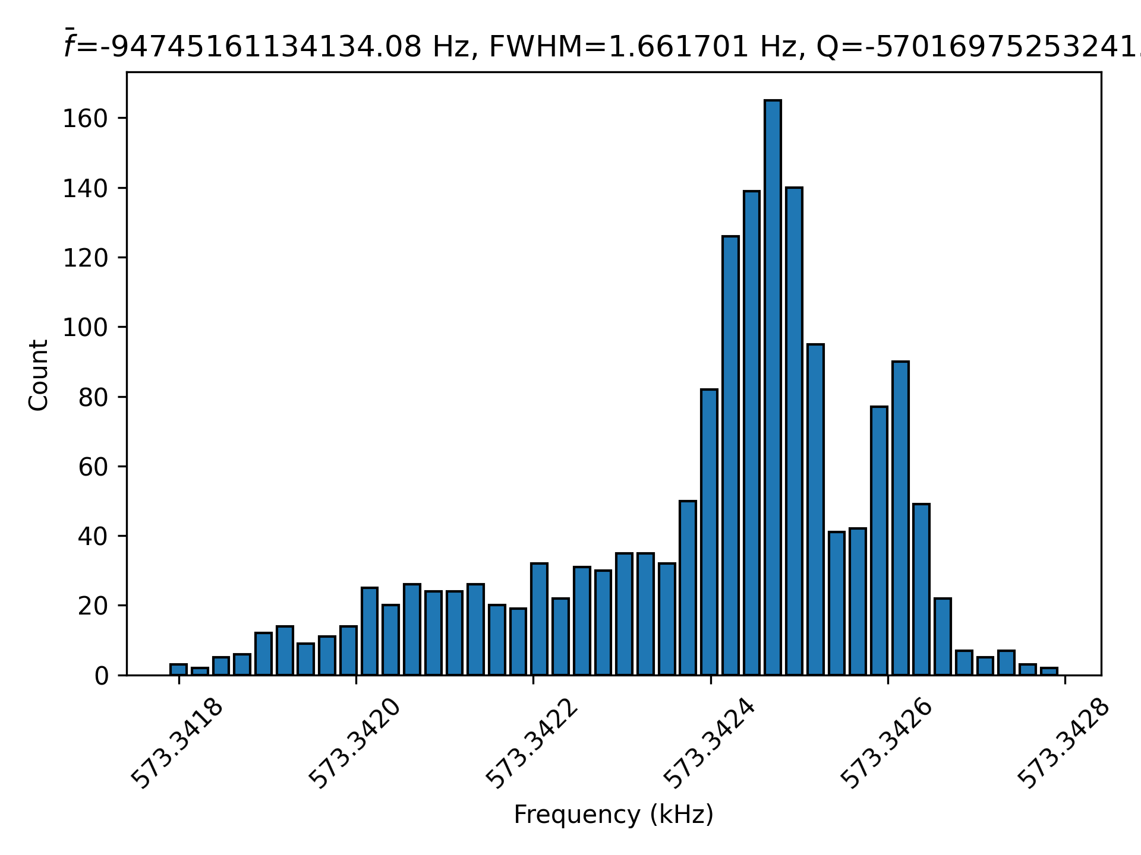
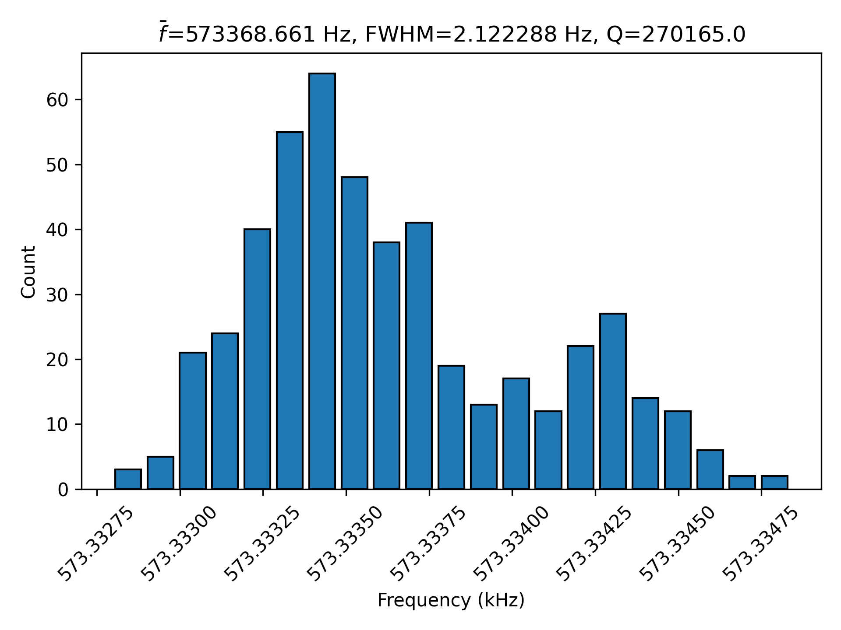
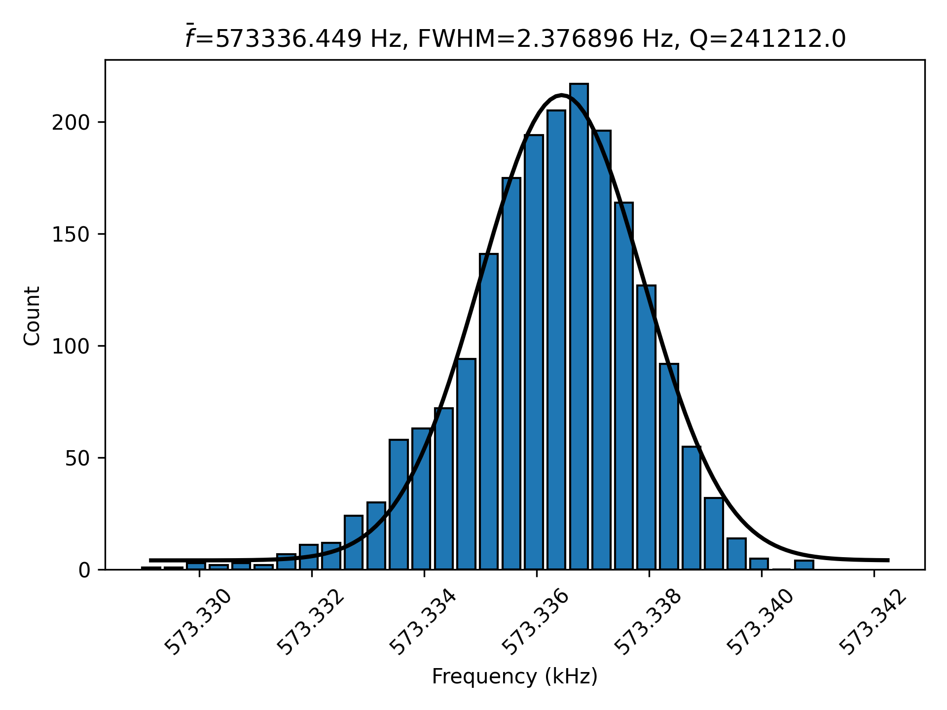
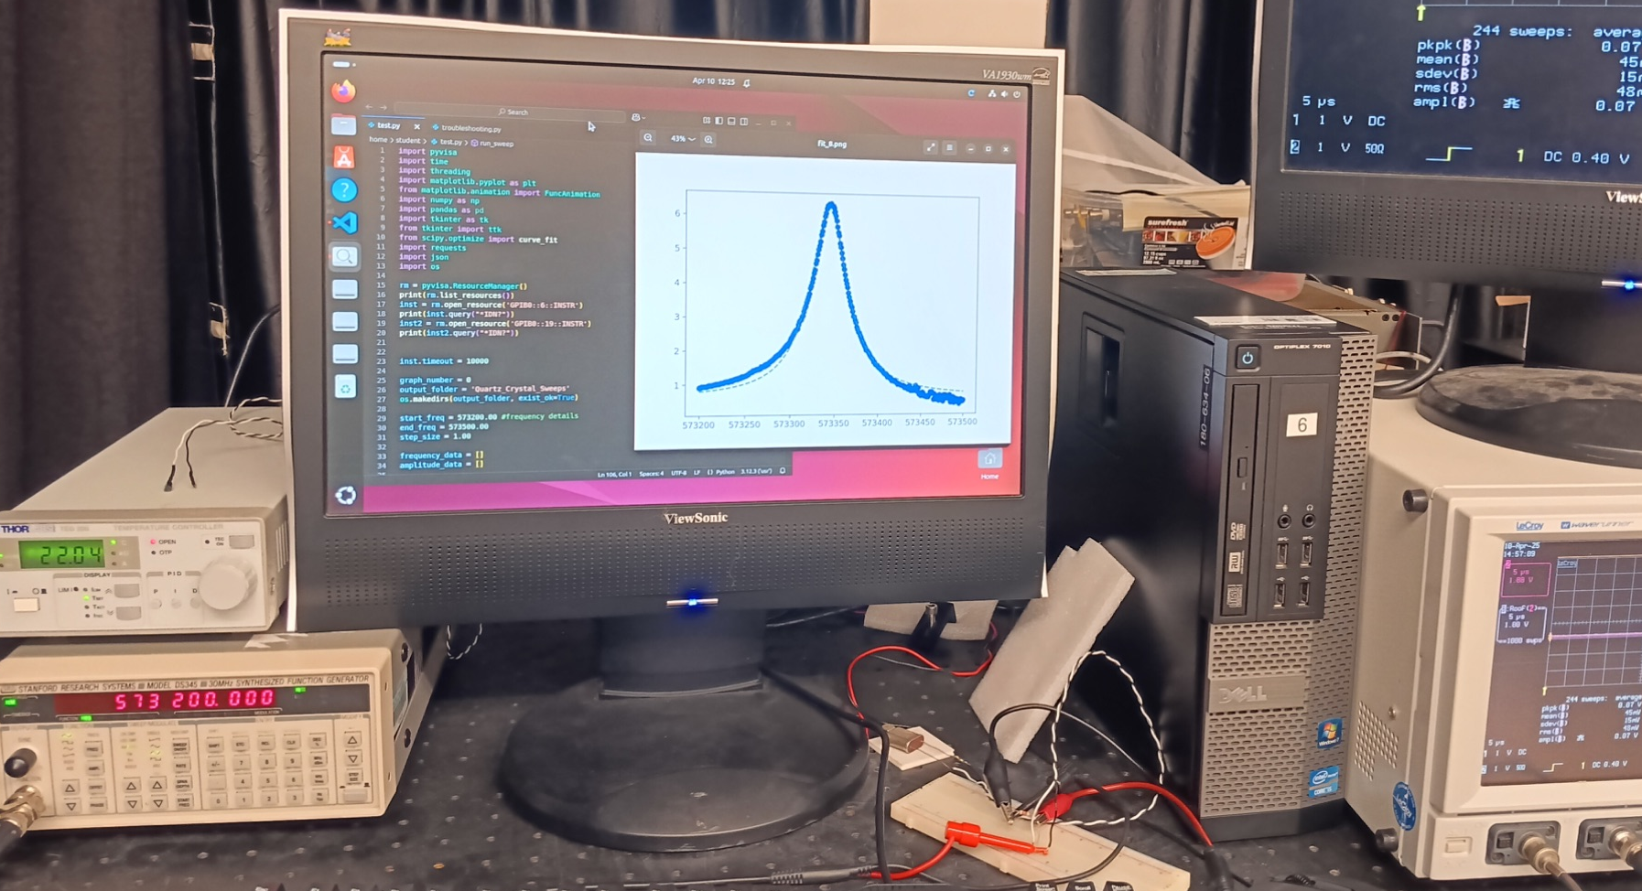
Observing resonance behavior of a temperature-regulated quartz crystal
Lucas Hill and Tom Bensky, Department of Physics
California Polytechnic State University, San Luis Obispo
Conclusions / Discussions
Introduction
Results
Based on the data collected, the temperature of the quartz crystal was a significant factor in the precision the resonance position. We see a dramatic increase in precision of the resonance position with temperature control.
The driving amplitude of the frequency sweep caused a bimodal resonance structure, indicative of an over-driven system. A lower amplitude resulted in a single-mode resonance structure.
Over a continuous sampling for 15 days, we conclude that our crystal has a Q=2.5x10⁵ at 27C, meaning if used in timekeeping applications, the crystal would allow for timekeeping to within 0.34 seconds/day.
Here we investigate the resonance of a temperature controlled quartz crystal to assess its use in timekeeping. The impedance of a crystal is known to drop dramatically at resonance, which we monitor electronically by connecting the crystal as the “other half” of a voltage divider, and sweep frequencies across the crystal while monitoring the voltage drop across it. After each sweep, we extract the centroid of the resonance, collecting 1000s after many days of computer-automated runs. We report a statistical analysis of the resonance position and observe a Q~10⁵, which can discipline a electronic oscillator to less than 1s/day.
We worked on several laboratory configurations, with and without temperature control and with large and small amplitudes of the frequency sweep (top and middle plots). We seem to fall into the regime of random errors only when under temperature control with a small driving amplitude (bottom plot).
Data taken from 2/11/25 to 2/24/25 with a maximum amplitude of 5V and no temperature regulation
IN THE LAB:
Varying frequencies are sent through a voltage-divider system to be read by the oscilloscope. The impedance of the crystal will drop at or near resonance frequency.
A Python script was developed to automate the resonance sweeps from just below to just above resonance, while recording the voltage across the resistor.
ANALYSIS:
Histogramming resonance centroids from 1000s of trials allows us to find a mean and standard deviation to determine quality factor or “Q”
Q=Δt/t and Q=f₀/Δf
t=Δt/(f₀/Δf)
Methods
Future Directions / Next Steps
We wish to compare findings of this work to atomic-disciplined oscillators. Also, we wish to investigate crystals with higher (i.e. MHz) resonance frequencies.
Data taken from 3/13/25 to 3/17/25 with a maximum amplitude of 5V and a constant temperature near 27°C
References
M. Lombardi “The Accuracy and Stability of Quartz Watches,” Horological Journal, pp. 57-59, 2008.
Atwood, A. W. Jr. (1933). A Free Quartz Pendulum: Electrostatically Driven and Photoelectrically Controlled as a Means of Precision Timekeeping. Master's thesis, California Institute of Technology. doi:10.7907/c5s0-qx08
Data taken from 3/17/25 to 4/2/25 with a maximum amplitude of 0.1V and a constant temperature near 27°C
Acknowledgements
Thank you to those who impacted and supported this project:
The Frost Fund
The Cal Poly Physics Department
Dr. Tom Bensky
Steve Soderberg
The equipment used to collect data for this project, along with the wiring.

